Slide 1
Session, course, and materials design

Slide 2
Train the trainer
Warm up – What did you learn yesterday

Slide 3
Train the trainer
Session 3 - Session, course, and materials design

Slide 4
Training requirements
What is the training topic?
Who are you training?
Where will the training be delivered?
When will the training take place?
Why are you training them?
We quote Chris Taylor – Earlham Institute - https://www.mygoblet.org/training-portal/materials/train-trainer-course-materials

Slide 5
Session Plan
Using Concept Maps to develop courses and sessions
Training session design and plan
Training materials: sharing and making re-use possible
Training materials repositories and resources: GOBLET, TeSS, GitHub, etc.
Reproducibility of compute environments
Training rooms for bioinformatics

Slide 6
What - Using Concept Maps to develop courses and sessions
Learning objective: Develop an understanding of concept maps, apply concept maps to the development of courses and course sessions

Slide 7
Concept Maps
Concept maps are graphical tools for organizing and representing knowledge (Novak and Cañas, 2008, "Theory underlying concept maps and how to construct them").
Nodes = concepts, knowledge
Edges = relationships between nodes
For students and teachers

Slide 8
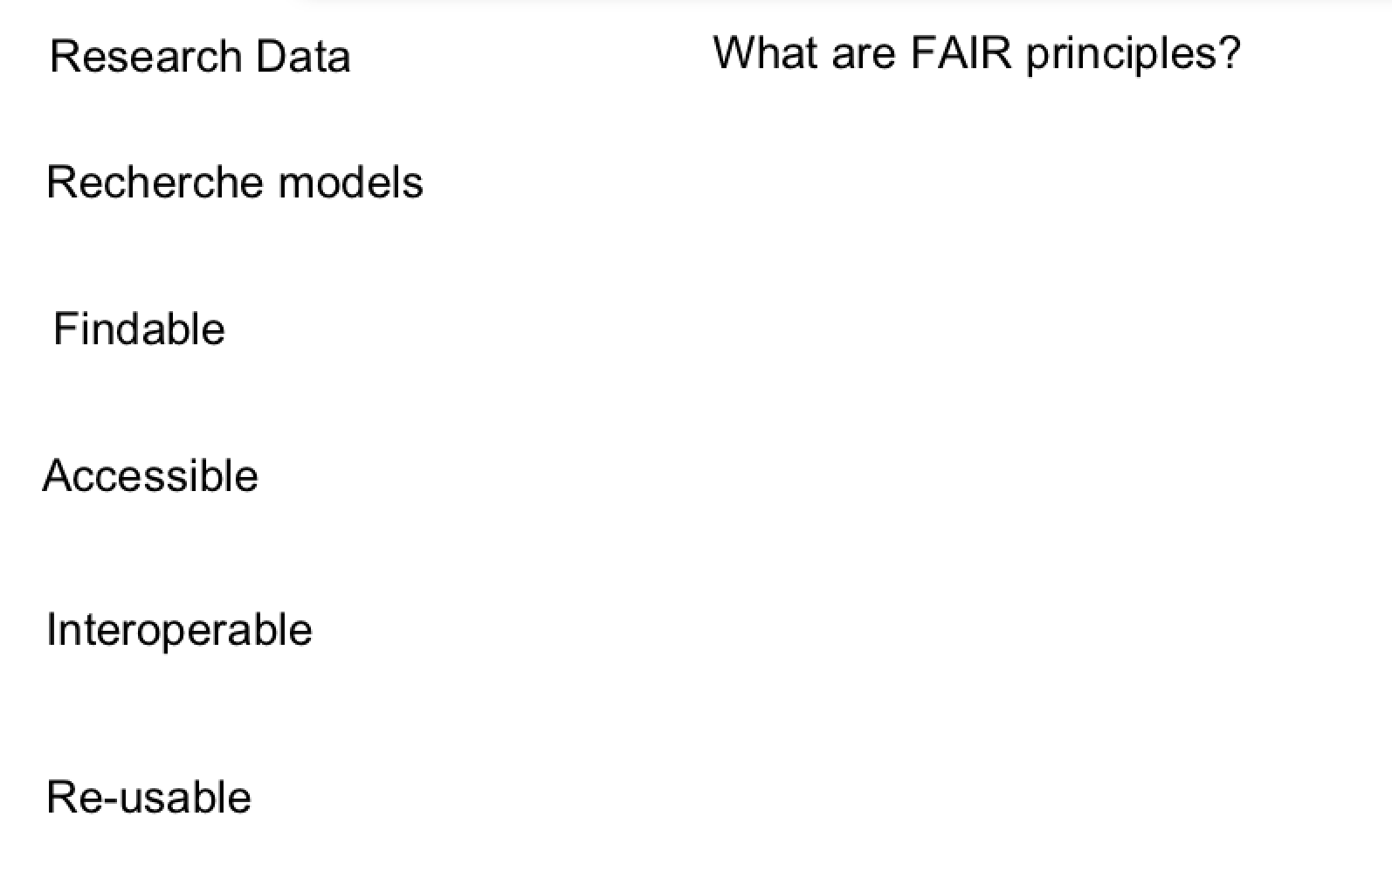
Concept map – FAIR principles

Slide 9
Concept map – FAIR principles

Slide 10
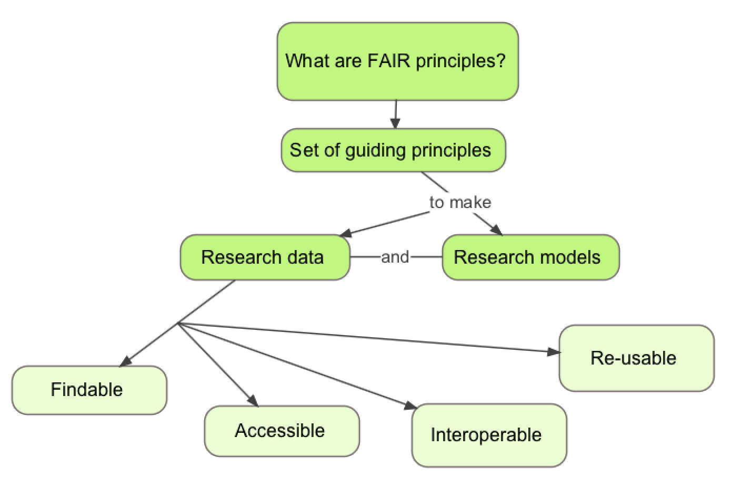
Concept map – FAIR principles

Slide 13
Activity (individual): Building up step by step the design of a very short lesson (3’ session)
Choose a topic you think you can teach in three minutes - Any topic
how to make an origami bird
introduction to biochemistry
how bats recognise the presence of obstacles
the second law of Newton
how to draw a comic strip, etc);
Draw a concept map for your mini-session; What are the concepts that you want the learners to learn and the relations among the concepts

Slide 14
Training session - design and plan
Learning objective: To reflect on, and to practice the design and planning of a training session

Slide 15
Training session - design and plan
Iterative and circular process:
Define the overall AIM
Define SMART learning outcome(s) related to the concepts, knowledge and skills you want the learners to develop (see concept maps).
Define the pre-requirements (what they bring, what you need to provide)
Define an evaluation (measure achieved learning outcomes), and the concepts/competencies/skills needed to succeed the evaluation.
Describe and create the course session activities, content, the process of the session (instructions), and any materials needed.
This is an iterative process and can/should be revised several times!
Notes:
Specific – precise outcome
Measurable – a definied element to demonstrate the outcome
Achievable – realistic given the contstraints (frame) of time resources
Relevant – Directly linked to a goal
Timely – Oncludes when the outcomes would be achieved

Slide 16
Activity (individual): Defining the content and resources of a 3’ session
Following up on the previous Activity (concept map):
Set a learning aim and a learning outcome;
Identify the target audience and prerequisites;
Decide:
active and interactive (practice to draw a stylised bicycle with you);
visual support
distribute some material in advance to the audience (e.g. paper for origami);
Sketch the structure of your presentation and the content
e.g., 40 secs introduction, 2 mins on topic, 20 secs conclusion;
Notes:
10 minutes exercise

Slide 17
Activity (group): Recording the 3’ session
You will be split into groups of 3 or 4;
Make sure your group has a laptop and a phone which can record video;
You need to each deliver your 3 minute session to the others;
One person delivers the session;
One person records on the phone;
One person notes down comments real-time;
You then provide feedback to each individual, and give your own comments on your delivery;
You then have time to revise your session, before delivering to the whole group.
Notes:
25-30 minutes exercise

Slide 18
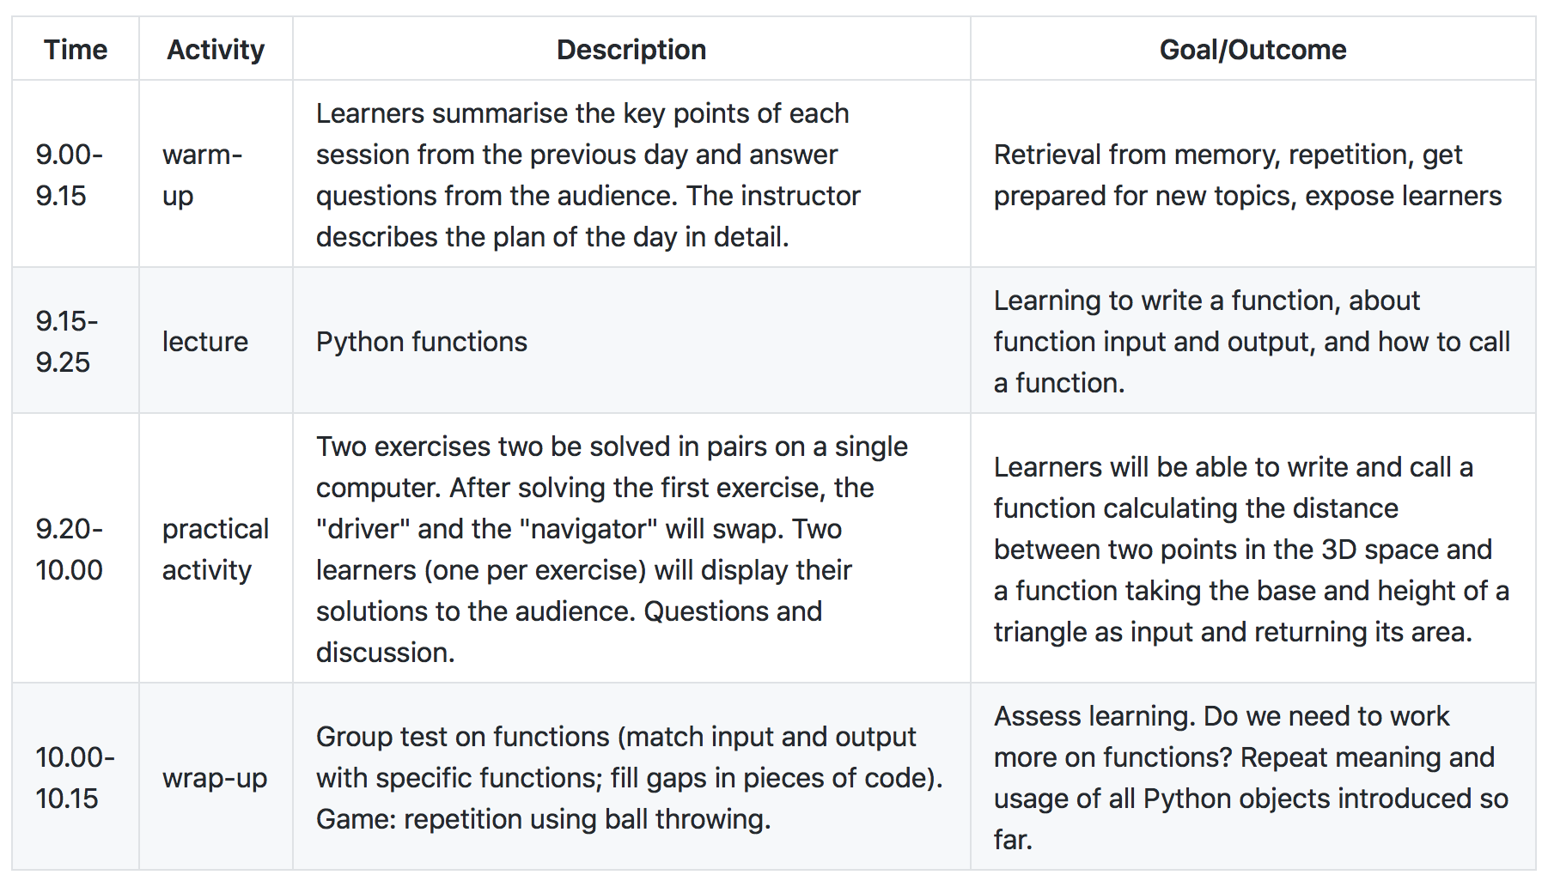
Example: Plan for a 1h15 session

Slide 19
From session to course – defining the aim
Combine the who, what and why requirements into a course aim
Who: write clear trainee specifications;
e.g. undergraduate biologists with basic knowledge of Unix and R
What & why: describe what trainees will learn, and the benefit of that
Consider the where and when requirements (i.e. the logistics)
How much can you do in the time available (including tests, feedback)
Resources limitations (space, equipment, assistants)
We quote Chris Taylor – Earlham Institute - https://www.mygoblet.org/training-portal/materials/train-trainer-course-materials

Slide 20
From learning outcomes to a course outline
A well-written course aim will guide the generation of LOs
LOs should then be instantiated as activities and quality checks
Learning activities: scripts, slides, exercises, tutorials, …
Assessment tools: creative activities, written tests, …
Feedback tools: observation, interaction, forms, …
Learning activities (LAs) should be tightly-linked to quality checks
This is not ‘teaching to the test’ because it’s training not education
When all the LOs are expanded, you have your course outline
LO #1
Learning Activities
Course Aim
LO #2
Assessment Tools
LO #3
Feedback Tools
We quote Chris Taylor – Earlham Institute - https://www.mygoblet.org/training-portal/materials/train-trainer-course-materials

Slide 21
Activity (group) - Challenge
In your group…
Take one session idea and expand to a “real” training session
You will need to:
Identify target audience
Define training session structure (include indicative content, length, breakdown and timings)
Set learning objectives and outcomes
Decide learning activities
Suggest how you will assess trainee progress
Let us know of anything else you will need to think about….

Slide 22
Training materials: sharing and making re-use possible
Learning outcome: Be able to identify training materials that exist already, and develop a routine of sharing training materials.

Slide 23
FAIR principles
Data and models are:
Findable - can be searched for by the community after publication
Accessible - can be read/downloaded by other researchers
Interoperable - can be understood clearly in the context of the original experiment
Re-usable - can be used by other researchers

Slide 24
FAIR principles – in the training context
Training course materials: slides, exercises, datasets
Findable - can be searched and found by the trainers community
Accessible - can be read/downloaded by other trainers
Interoperable - can be understood clearly in the context of the original course
Re-usable - can be used by other trainers

Slide 25
Training materials repositories and resources
GOBLET – http://mygoblet.org/training-portal
TeSS - https://tess.elixir-europe.org/
GitHub - https://github.com
Jupiter - http://jupyter.org/
Other?

Slide 26
Reproducibility of compute environments
Different courses, different compute requirements: Unix, R, Python, metagenomics, long read sequencing
Installation process time-consuming and technically challenging
Every computer should have an identical installation setup and sufficient hardware (power and memory) to run the tools
Virtual machines, cloud computing, containers, software images

Slide 27
Training rooms for bioinformatics
Physical environment
Room geometry: seats’ quality, the lighting, the room temperature control, the stability of power and network connections
Functionality : video, audio, drawing surfaces (whiteboard, flipchart paper), a corkboard to pin materials
Hardware needs: power suppliers, network connections with a good quality wifi access

Slide 28
Wrapping up
What did you learn in this session?
- One person a time, no repetition

Slide 29
Wrapping up
Using Concept Maps to develop courses and sessions
Training session design and plan
Training materials: sharing and making re-use possible
Training materials repositories and resources: GOBLET, TeSS, GitHub, etc.
Reproducibility of compute environments
Training rooms for bioinformatics

Slide 30
Train the trainer
Session 4 - Assessment and feedback in training

Slide 31
Session Plan
Introduction to assessment and feedback in training
Pre-course assessment - Diagnostic questionnaires
Feedback to learners
Summative and formative assessment
Feedback from learners
Systematic Feedback
Short term feedback - assessment of training quality, participant and instructor performance
Long term post-course feedback
Dealing with (bad) feedback

Slide 32
Assessment
the evaluation of a student's achievement on a course
Feedback
a reaction or response to a particular process or activity
We quote Dictionary.com

Slide 33
Practice makes perfect
Practice with feedback makes perfect

Slide 34
Feedback
The feedback itself is not important, but what you do with it is …
Giving and receiving

Slide 35
Activity (individual) - Challenge 1: what kind of feedback/assessment do you know as a learner or use as a trainer?
What type of assessment did you undertake as a learner or trainer?
What was its purpose in your opinion?
Was it useful to your learning or teaching?
Reflection – 5’

Slide 36
Pre-course assessment - Diagnostic questionnaires
Useful tools - to get an idea of where the learners and the group of learners stand before the course starts
setup realistic learning objectives,
meet expectations of learners,
adapt the course content to fill gaps identified in the diagnostic questionnaire,
avoid spending time in things that are not necessary.

Slide 37
Pre-course assessment - Diagnostic questionnaires
Anonymous
Level of knowledge of the whole group of learners
Non-anonymous (individual answers)
Learner has a necessary pre-required knowledge, and in the negative case indicate an appropriate teaching choice to palliate this lack.
Example: Unix questionnaire before an HPC course

Slide 38
Feedback to learners
Anything we do to help both ourselves, the instructors, and learners to get information about whether learning
is occurring (if during the teaching)
or has occurred (at the end of the teaching).

Slide 39
Summative x Formative assessment
Summative: is aimed at evaluating learners' performance at the end of teaching.
When: at the end of a topic, a session, or at the end of the entire course.
Frequently occurs in schools and universities and usually includes grading. It is less frequent in training.

Slide 40
Summative x Formative assessment
Formative assessment: during teaching and learning.
"Classroom assessment's purpose is to improve the quality of student learning, not to provide evidence for evaluating or grading students. The assessment is almost never graded and are almost always anonymous."
We quote Angelo & Cross [Classroom Assessment techniques, a Handbook for College Teachers)]

Slide 41
Formative assessment
Can help understand:
knowledge gaps need to be filled before moving on
If their mental models are correct
if the level of mastery is sufficient according to the course's learning objectives and outcomes
if learners goals and objectives are aligned to the course's goals and objectives
types of mistakes need special attention

Slide 42
Self-assessment, self-confidence and usage independence
Active learning:
learners so involved in the learning process loose consciousness about accumulated knowledge
Good quality training
instructors make efforts to keep the interaction loop closed, contribute to build-up
At chosen times: intervene and stimulate self assessment

Slide 43
Instant feedback
Minutes cards; One-up, one-down - are forms of Instant Feedback.
Fist or Five Feedback
Socrative app

Slide 44
Instant feedback - benefits worth noticing
For the LEARNER:
obliges the learner to introspect, to answer himself first (do I really know this? How easy it is for me to do this by myself?)
awareness of own progress -> smartest way to gain self-confidence
when questioned at the end-of the course, much more able to make encompassing self assessments
For the INSTRUCTOR:
checking effectiveness
assessment - quality of materials and performance of instructor
identify learners - dragging behind and need more attention
identify learners - getting ahead of the group (receive harder assignments, help their colleagues, etc.)
judge the pace of training delivery - correct for the audience

Slide 45
Feedback
The feedback itself is not important, but what you do with it is …
Giving and receiving

Slide 46
Activity (individual) - Post-course feedback - organisation
Write in the post-it the kind of information we would like to collect once the course is over
Reflection – 5’

Slide 47
Post-course feedback - organisation
From very bad to excellent
Information
website
registration process
venue
IT support
Catering
Social dinner
Overall organization

Slide 48
Post-course feedback – course content
Topics were relevant for my work/research interests
Inspired to new ways of thinking
Lectures were clearly presented and comprehensible
Pace of teaching was right
Teaching aids used (e.g. slides) were well prepared
Hands-on exercises and demonstrations were a valuable contribution to the course
Course too short, too long, the right length
Yes, rather yes, rather no, no, no opinion

Slide 49
Post-course feedback – appreciation
Would you suggest this course to a friend/colleague?
The course met my expectations
Overall, how would you rate this course?
What did you like most about the course?
What did you like least about the course?
Additional comments and suggestions on the content, specific lectures, specific trainers, etc.
Yes, rather yes, rather no, no, no opinion

Slide 50
Long term post-course feedback – impact
Change
employment sector
confidence/competency in the resource(s)
work/research
collaborations with the other course participants, colleagues

Slide 51
Summary- When and why to assess
Before the course - pre-course assessment - verify the target audience of the course
Beginning of the course - preventive assessment - final adjustments of the course to the reality of the participants
During the course - formative assessment - pilot in real time if learning is taking place
At the end of the course - summative assessment - measure and evaluate the knowledge and skills acquired
Right at the end of the course and long time after the course - strategic evaluation - measure the adequacy, quality and impact of the course

Slide 52
Dealing with (bad) feedback
Trainees feedback should be considered along other forms of quality evidence:
Review what they have effectively learned (in exams)
Consider your own experience of teaching
Discuss with colleagues and friends
Look at the feedback from past sessions of the same course

Slide 53
Dealing with (bad) feedback
Breath deeply
Look at the response rates
Look at the counter examples (contradictions)
Look at the repetitive patterns (not at only one single answer)
Humans focus more on negative feedback than on positive (you are not alone)
Try to see the point in the criticism, learn from it
Don’t take it personally (easier said than done). Try to focus on what they say about what you do (not who you are)

Slide 54
Activity (individual): Give us your feedback
Our teaching
Our course

Slide 55
Activity (individual): reflective thinking
Let us know:
Your own learning experience – Self-assessment

